Slide 1


Research into efficient rendering of large data sets
By Rachel Chu and Daniel Tenedorio

Slide 2

This report describes a nine-week research project as part of UCSD’s PRIME 2008.
The project took place at UCSD, Taiwan’s National Center for High-Performance Computing, and Osaka University’s Cybermedia Center.
The goal of our project: optimize the rendering part of the pipeline for a three-dimensional videoconferencing system.
To gain a familiarity with the techniques involved with rendering large data sets, we spent two months experimenting with different software packages.

Slide 3

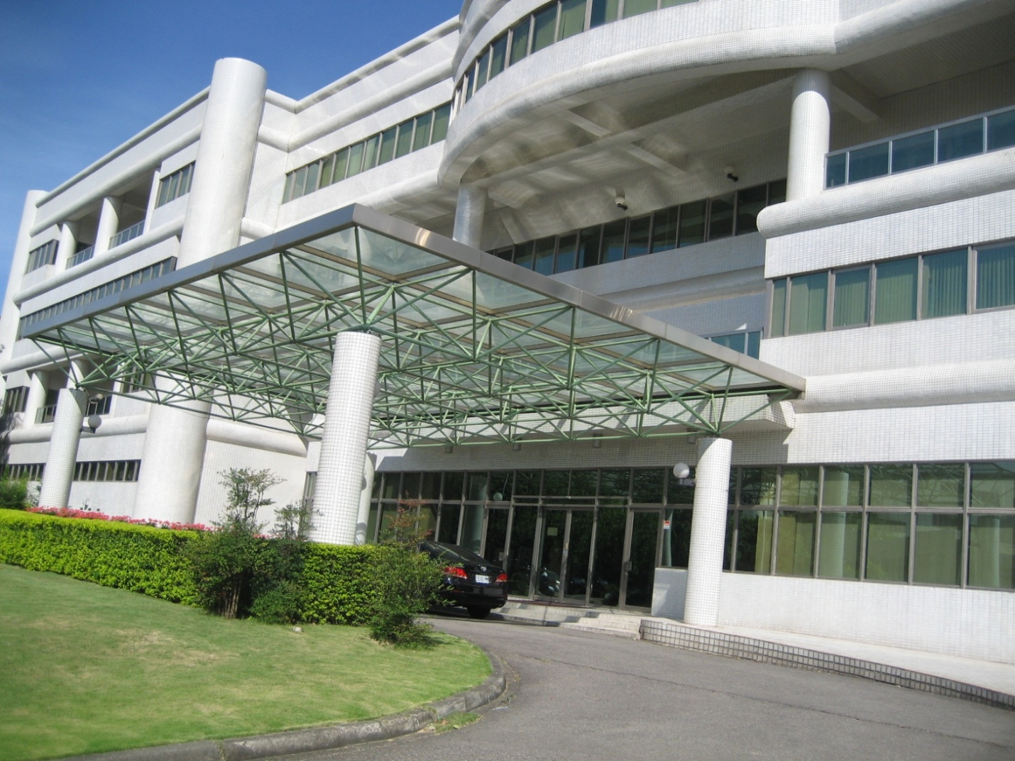

Slide 4

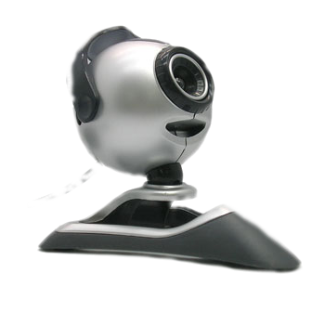
Each person stands before a camera and microphone.
The camera takes video footage of the speaker, while the microphone records sound.
The audio/video information is sent over a network of some kind to the other person.
The transmitted information is played back in real-time.

Slide 5

The goal of this project is for each speaker to be involved in as realistic of an experience as possible.
For now, though, the research is limited to one sender and one receiver.
Multiple cameras encircle the sender and take continuous footage.
Computer software analyzes the camera images and generates a series of point clouds. A point cloud is a set of three-dimensional points in space (including color).
Ten to twenty times per second, a full point cloud is sent over a fast network connection to the receiver.

Slide 6
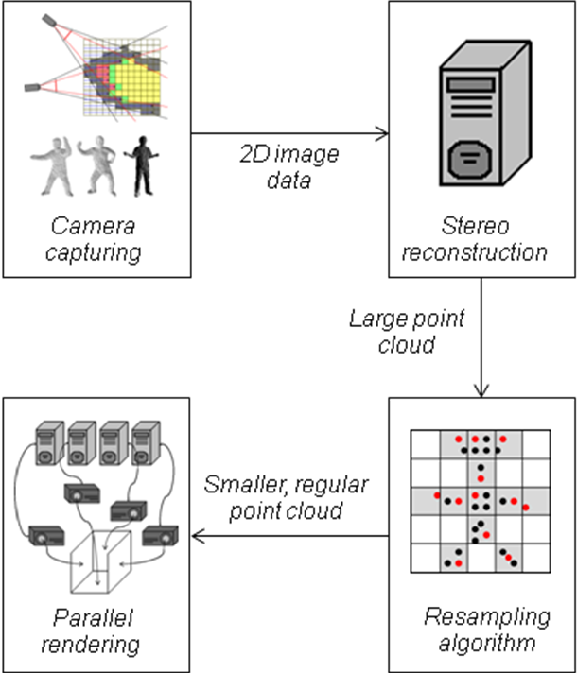

Slide 7

The receiving software must recreate a snapshot of the sender from a highly detailed point cloud in only a fraction of a second!
One idea is to just draw each point in order. But what if the next frame comes before drawing is complete?
One approach involves generating a hierarchical data structure that can be drawn at different levels of detail (like how many web browsers will redraw images in higher and higher resolutions as they receive the data).
Another involves creating a triangle mesh from the points and feeding it into one of many existing renderers.

Slide 8

Progress on the project proceeded as follows:
First, we installed the hardware. We used a Dell desktop computer with a 3.4 GHz Pentium D processor and an nVidia 7900GS graphics card.
Then, we set up our software environment. We conducted research using Ubuntu Linux 8.04, running visualization tests with COVISE.
After these setup steps, we obtained various 3D point models and created animations of them for testing.
Our first research approach was to investigate real-time methods for creating triangle meshes.

Slide 9

Three-dimensional data is usually stored in triangle meshes. Each mesh comprises a numbered list of points, and a list of integer triples specifying triangles.
If there was a way to generate a triangle mesh from a point cloud quickly, existing renderers could draw the triangles.
Unfortunately, timing tests revealed that drawing a triangle mesh of about 100,000 vertices took twenty times as long as drawing the points directly!
Because the data is captured as points, this makes real-time meshing infeasible.

Slide 10

After discovering that point clouds rendered much faster than triangle meshes, we modified our approach to handle large numbers of points.
Our first idea was to use existing research that described ways to subdivide point clouds for purposes of compression, but doing this in real-time was infeasible. We needed an algorithm that processed each point exactly once per frame.
We ended up creating an algorithm to quickly resample the cloud, using system RAM to hold the new cloud.

Slide 11

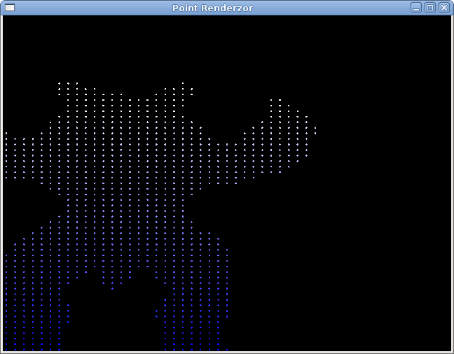
The final approach we tested was able to render an approximation of about one fifth of the points in less than the time it took to simply render them all.
The idea was to divide the 3D space into cells, and use computer memory to store whether each cell contains one or more points.
This approach is analogous to the 2D approach of first drawing images into a section of computer memory, then quickly coping the section to the output device (screen).
The procedure runs quickly because it runs in one function call, processes each point only once, and uses only floating point subtraction and integer bit shifting.

Slide 12
What comprises a CAVE system
We established an immersive virtual reality environment at Osaka University’s Cybermedia Center called a CAVE.
CAVE stands for Cave Automatic Virtual Environment.
It comprises a stereoscopic theater of sixteen projectors and four screens, located in a darkened room.
One computer controls each set of four projectors with orthogonally polarized filters.
The viewer wears orthogonally polarized glasses; both images combine to create the illusion of depth.
With the addition of head tracking, the viewer can see the image at various angles at his or her convenience.

Slide 13
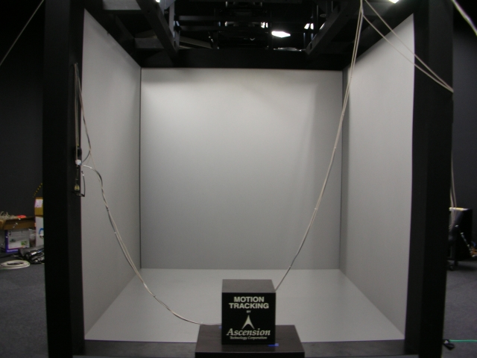

Slide 14

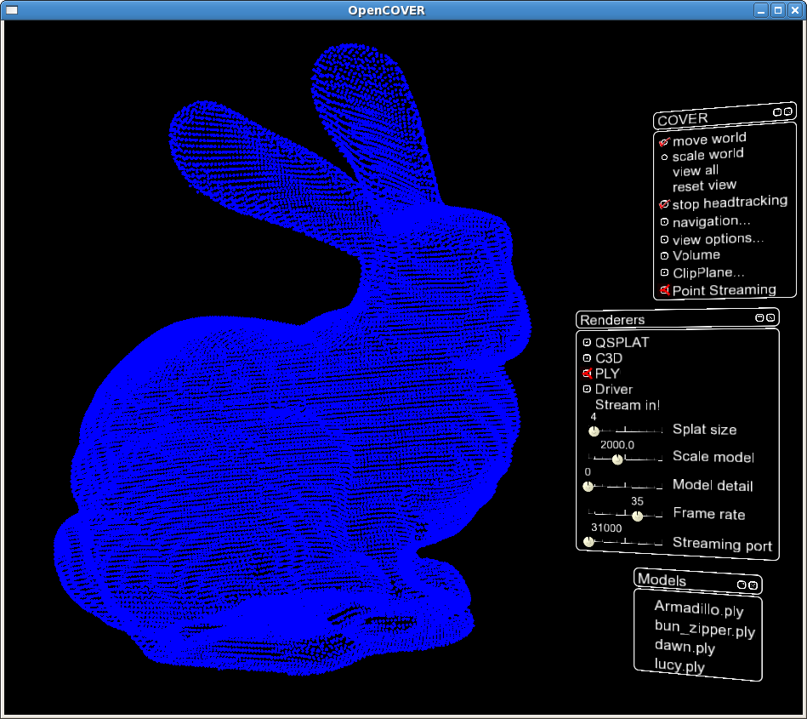

Slide 15

I would like to thank the following people for their help:
Dr. Peter Arzberger
Dr. Gabriele Wienhausen
Dr. Jurgen P. Schulze
Teri Simas
Fang-Pang Lin from NCHC
John Clegg and Li Chu Cheng from NCHC
As well as these organizations:
The United States National Science Foundation
Calit²
PRAGMA

